Slide 1
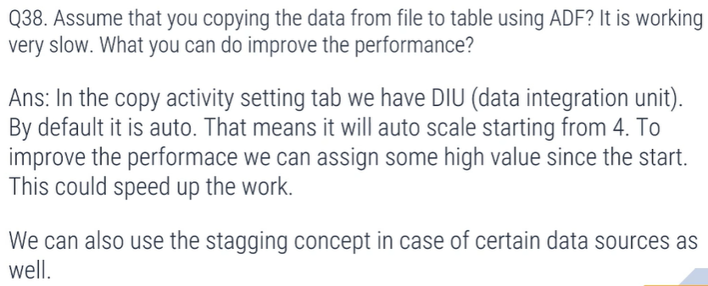
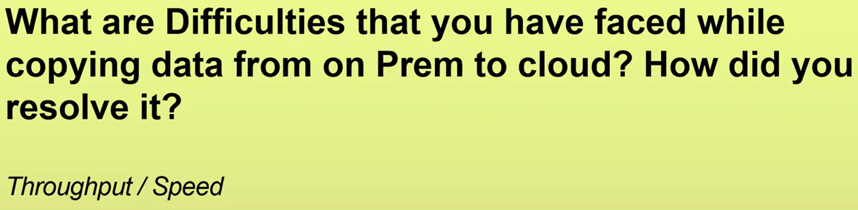

Slide 2
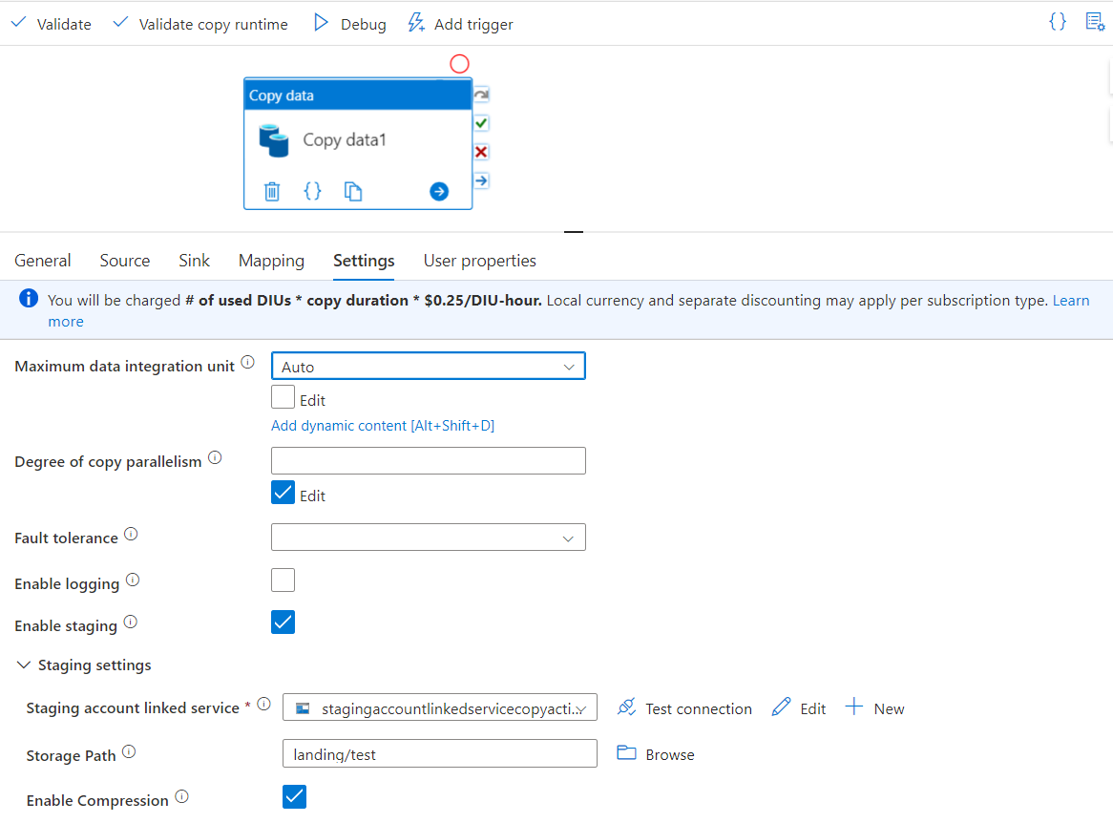
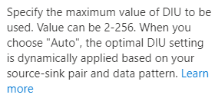
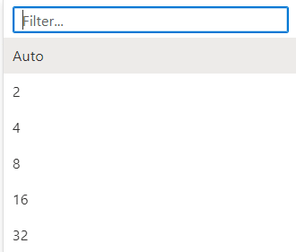
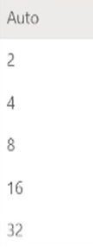

1) DIU (Data integration unit)

Slide 3
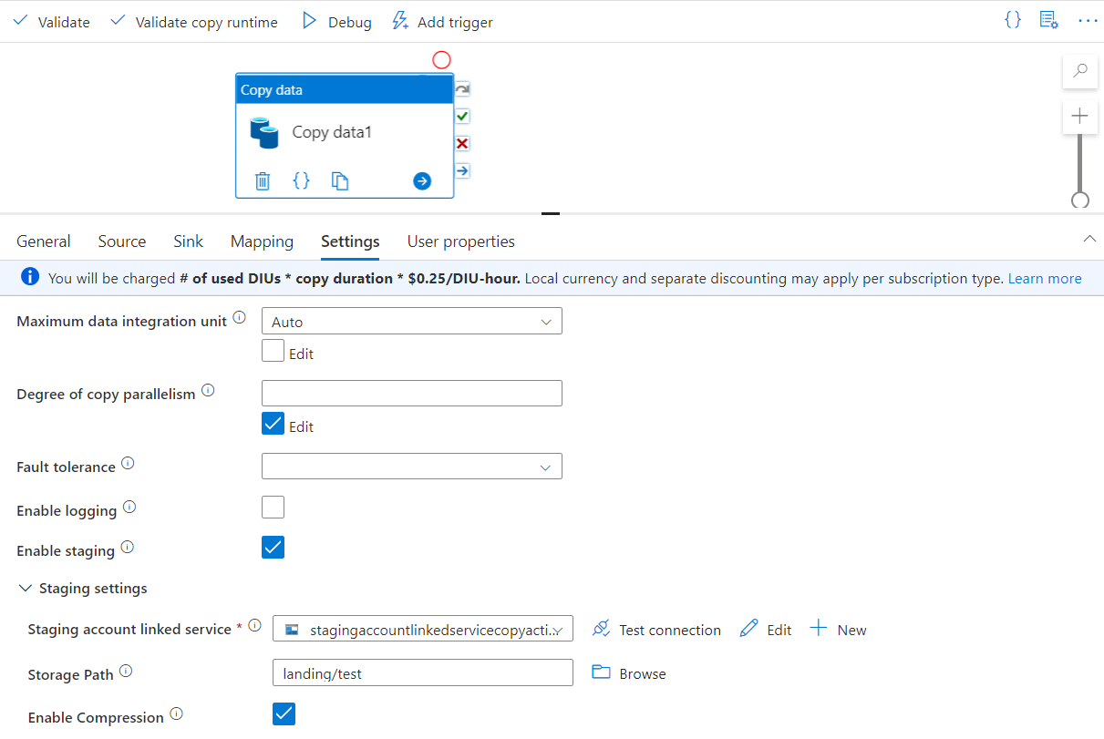
2) Staging
Enable staging
Enable Compression
Suppose am copying data from SQL server to ADLS GEN2
Source : SQL Server
Sink : ADLS GEN2
1) This copy will be slow no matter what; on-prem to any cloud will definitely be slow
Whenever it is trying to copy your data from on-prem, it will compress your files and when loading it back into your ADLS GEN2, it will decompressed. Now your data transfer in compressed mode because of that the speed of data transfer will be very high. Now because of compression & decompression is happening in b/n ADF needs staging area. It just needs a storage account to store the files temporarily.

Slide 4
